Slide 1
Unveiling Zeus Automated Classification of Malware Samples
Abedelaziz Mohaisen Omar Alrawi Verisign Inc, VA, USA Verisign Labs, VA, USA oalrawi@verisign.com amohaisen@verisign.com
CMSC 691 Advanced Malware Analysis
Presented by
Rajesh Avula

Slide 2
Classification
Malware family classification is an age old problem that many AntiVirus (AV) companies have tackled.
There are two common techniques used for classification,
Signature based
Behavior based
Signature based classification uses a common sequence of bytes that appears in the binary code to identify and detect a family of malware.
Behavior based classification uses artifacts created by malware during execution for identification.
In this paper
we report on a unique dataset we obtained from operations and classified using several machine learning techniques using the behavior based approach.
Our main class of malware we are interested in classifying is the popular Zeus malware.
For its classification we identify 65 features that are unique and robust for identifying malware families

Slide 3
Zeus malware (banking Trojan)
The Zeus malware infects the system by writing a copy of itself to the APPDATA folder using a randomly generated file name. The stolen data is stored under the same directory, APPDATA, encrypted.
The Zeus banking Trojan hooks several important Windows APIs to intercept data being sent from the browser and to modify pages seen by the victim.
Because Zeus is capable of adding fields in web forms to collect additional information from the victim when visiting banking site.
The configuration file can contain a list of backup command-and control servers, link to an updated version of Zeus, list of targeted websites, and list of HTML and JavaScript to be injected in the targeted websites.

Slide 4
Machine Learning algorithms
Support Vector Machine
Logistic Regression(L1 and L2 norm)
Decision Tree
K-Nearest Neighbor

Slide 5
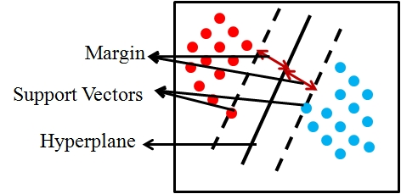
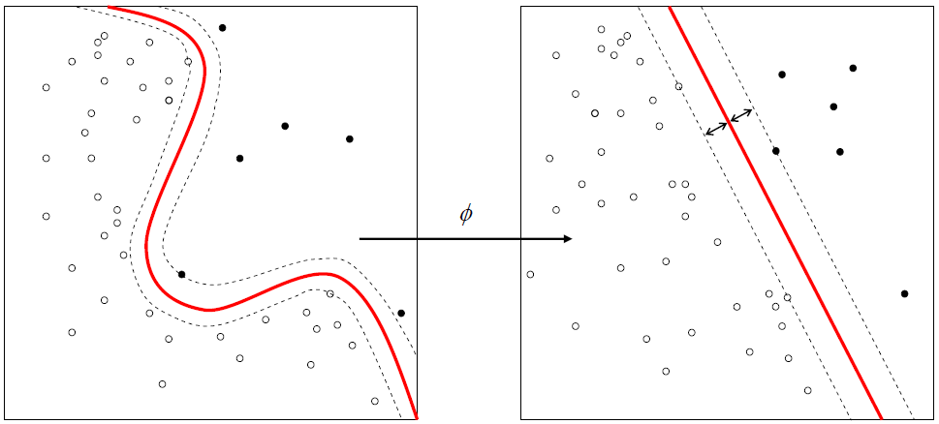
Support Vector Machine(SVM) kernel trick
Support Vector Classification: (also known as support vector machine; SVM) is a supervised deterministic binary classification algorithm that assigns a label to input determining which of two classes of the output it belongs to.
Given a training set of samples (i.e., examples), each of which is marked as belonging to one of two categories, the algorithm builds a model that assigns each of the samples into one category or the other.

Slide 6
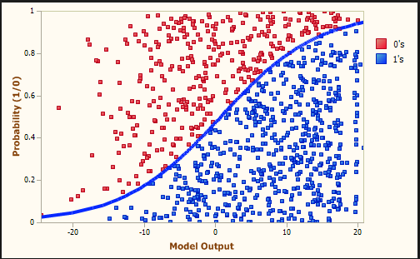
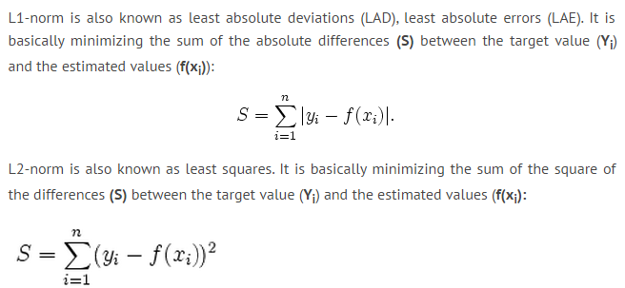
Logistic Regression
same as the SVM, logistic regression allows us to predict an outcome, such as label, from a set of variables.
The goal of logistic regression is to correctly predict the category of outcome for individual cases using the best model.
In our experiments, we use both L1 regularization and L2 regularization In this study, we use both to identify the better one for the given dataset size and set of features.

Slide 7
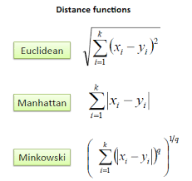
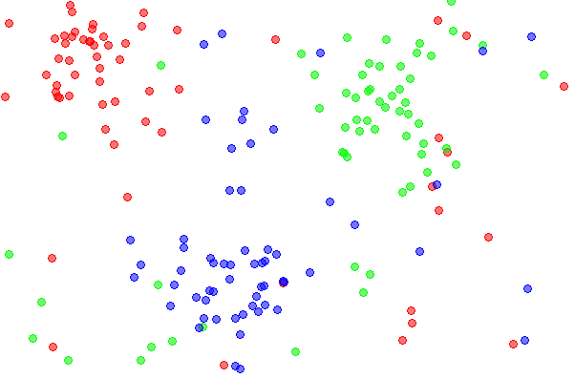
K-Nearest Neighbor

Slide 8
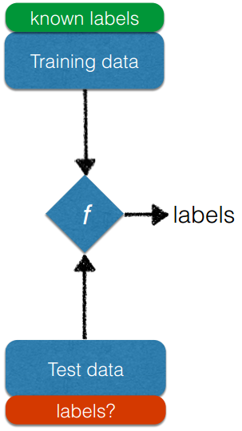
Decision Tree
It is a model used for predicting the label by mapping observations about the sample to the conclusions about its target value.
In the training part, the samples are used to create a model in which a boundary is created for each label based on the features.
In the test part of the algorithm, the decision model created earlier is used for identifying which label is associated with the sample based on how it is fitted on the classification tree.

Slide 9
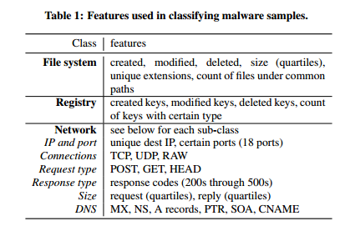
Raw and Vector Features Extraction
The dataset is a set of 1,980 sample of the Zeus Banking Trojan. We ran these 1,980 samples through our automated malware analysis system auto-mal. The system auto-mal is a virtual machine (VM) based system that is used to run samples of malware and capture behavior characteristics of that sample.

Slide 10
Dataset and Labeling
Sample Labeling
Training and Testing data
The Zeus Banking Trojan samples have been identified by hand and collected over time by analysts
This process can be time consuming. At average, a previously unseen malware sample (not necessarily Zeus) can take more than 10 hours to manually characterize by experts.
The data sources are from various AV vendors that we have partnered with for sharing malware samples. The malware feed is delivered with no AV signatures associated with samples.
We run Yara signatures on the malware feed to identify malware of interest that we can feed into our automated malware analysis system.
The Zeus data set is split up into 2 different data sets one for learning and one for testing.
The learning data set contains 1001 samples of Zeus and 1000 samples of other malware that is picked at random from their malware database collection.
The testing set contains 979 samples of Zeus and 1000 samples of non Zeus malware and that is not found in the learning data set.

Slide 11
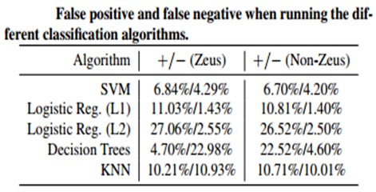
Results
For the KNN classifier the number of nearest neighbors are set to 980
The false positive error (false alarm; for the class label Zeus, for example) measures the number of samples marked as Zeus, while they are in reality not Zeus.
The false negative error (for the Zeus family) measures the number of samples that are marked as non-Zeus, while they are in fact Zeus.

Slide 12
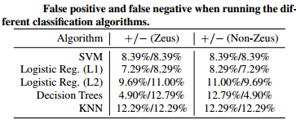
Challenging problems
when using machine learning techniques for classifying data, particularly when using supervised learning techniques, is the choice of the training set.
To understand how results are robust to the initial training set, repeat the experiment by flipping the test and training datasets.

Slide 13
Thank You

